Slide 1
Gas Lift

Slide 2
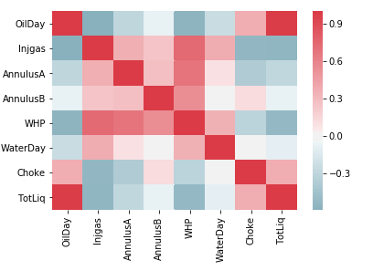
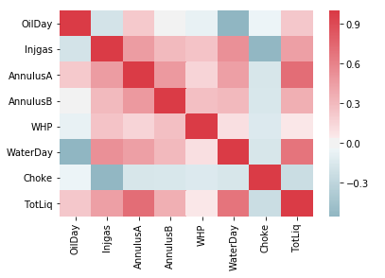
CORRELATION PLOT
WELL A
WELL B

Slide 3
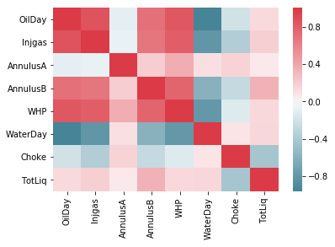
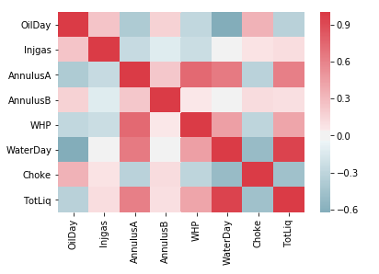
CORRELATION PLOT
WELL C
WELL D

Slide 4
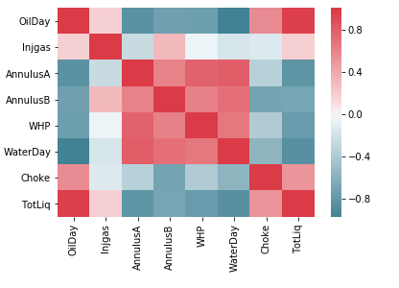
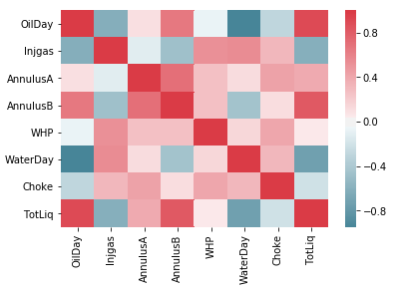
CORRELATION PLOT
WELL E
WELL F

Slide 5
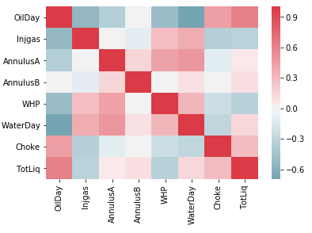
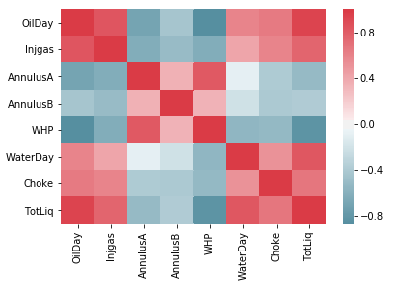
CORRELATION PLOT
WELL G
WELL H

Slide 6
RESULTS TABLE
WELL | A | B | C | D | E | F | G | H
ERROR OIL % | 3.777 | 4.364 | 23.335 | 12.783 | 6.67 | 33.25 | 9.055 | 10.678
ERROR WATER % | NA | 17.73 | inf | inf | inf | inf | 6.71 | INF
ERROR TOTAL % | 3.993 | 2.596 | 4.168 | 5.5 | 3.166 | 8.65 | 2.877 | 10.614
OPTIMUM INJGAS, Oil | 10000, 60.82 | 10000, 62.315 | 10000, 21.95 | 10000, 23.635 | 10000, 84.645 | 10100, 18.742 | 10000, 63.937 | 15000, 40.727
OPTIMUM INJGAS, WATER | 10000, 0.023 | 10000, 15.83 | 10000, 36.38 | 10000, 62.55 | 15000, 5.713 | 13400, 39.33 | 10000, 85.738 | 15500, 3.062

Slide 7
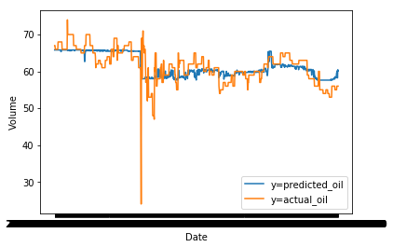
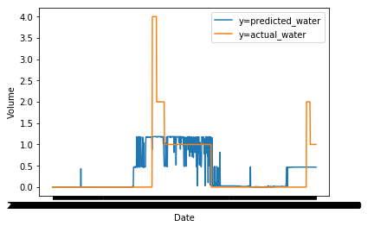
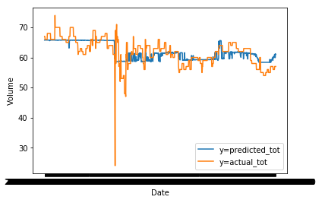
ACTUAL VS PREDICTED WELL A

Slide 8
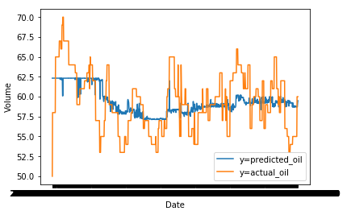
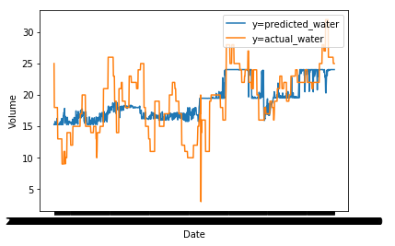
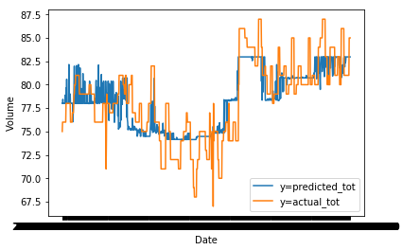
ACTUAL VS PREDICTED WELL B

Slide 9
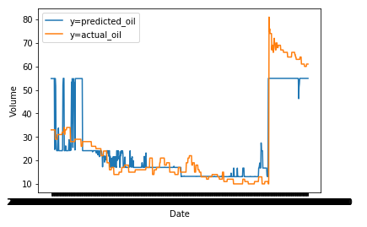
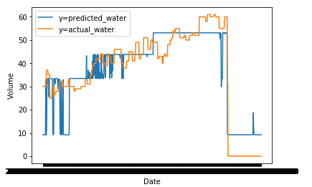
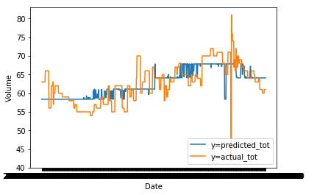
ACTUAL VS PREDICTED WELL C

Slide 10
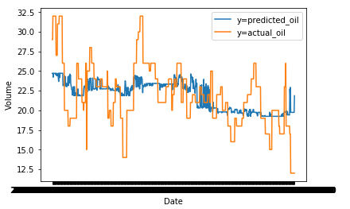
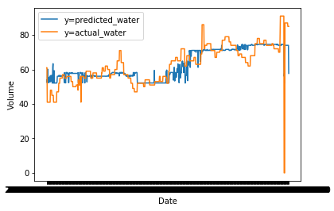
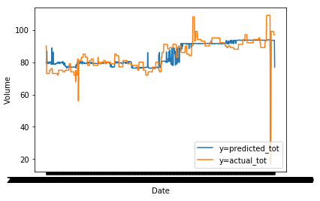
ACTUAL VS PREDICTED WELL D

Slide 11
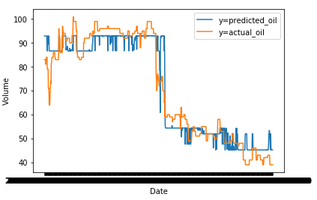
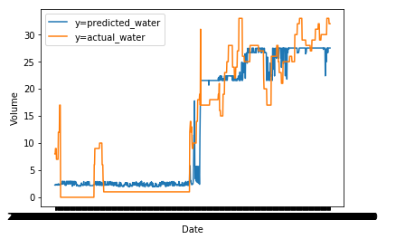
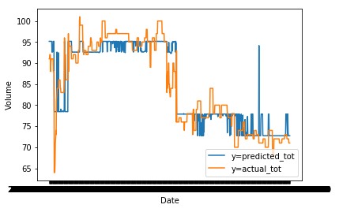
ACTUAL VS PREDICTED WELL E

Slide 12
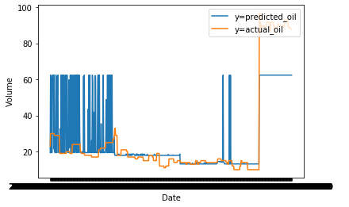
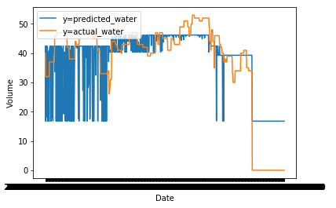
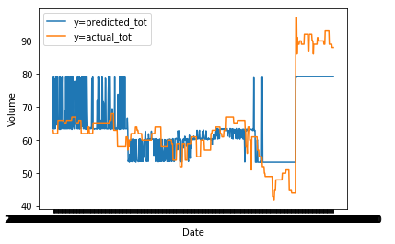
ACTUAL VS PREDICTED WELL F

Slide 13
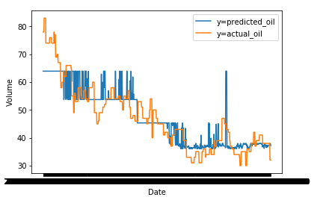
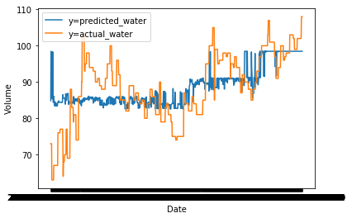
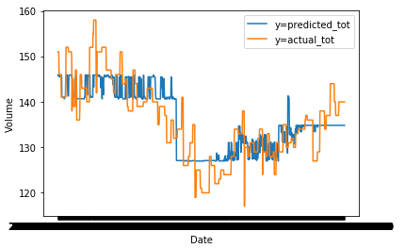
ACTUAL VS PREDICTED WELL G

Slide 14
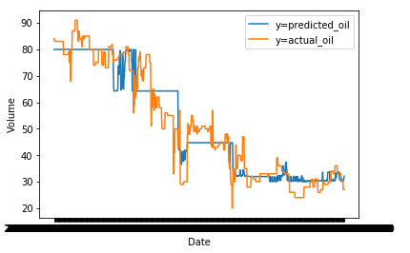
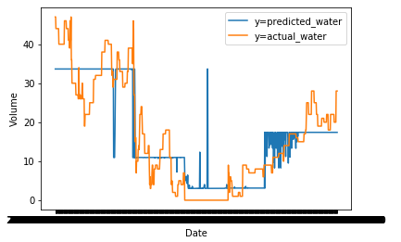
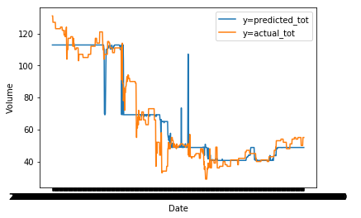
ACTUAL VS PREDICTED WELL H

Slide 15
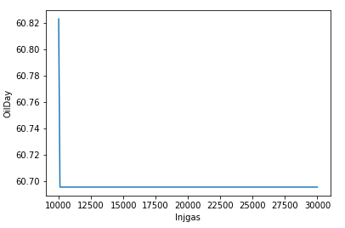
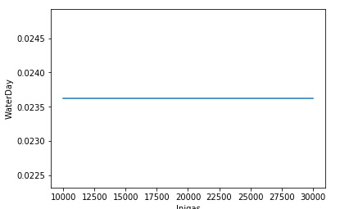
OPTIMUM INJGAS WELL A

Slide 16
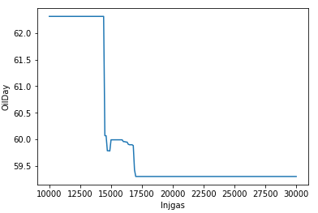
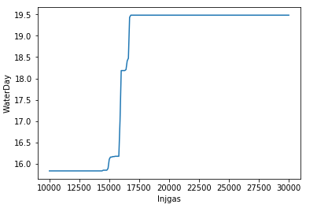
OPTIMUM INJGAS WELL B

Slide 17
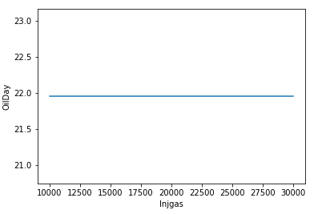
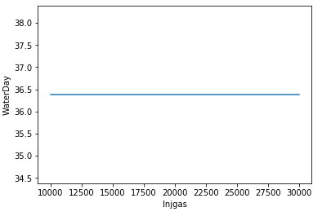
OPTIMUM INJGAS WELL C

Slide 18
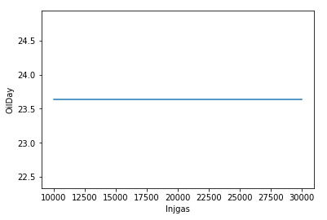
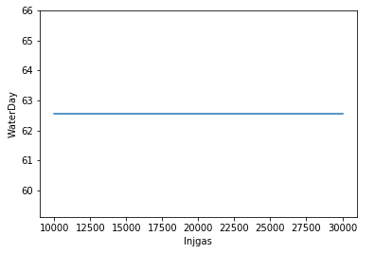
OPTIMUM INJGAS WELL D

Slide 19
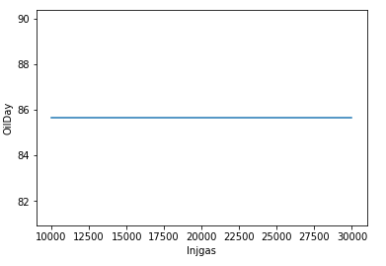
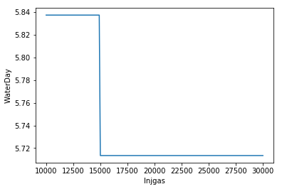
OPTIMUM INJGAS WELL E

Slide 20
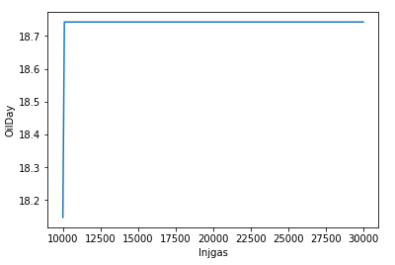
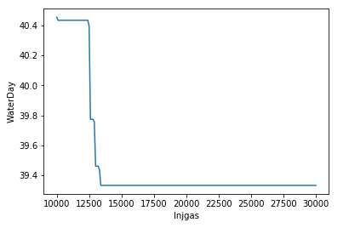
OPTIMUM INJGAS WELL F

Slide 21
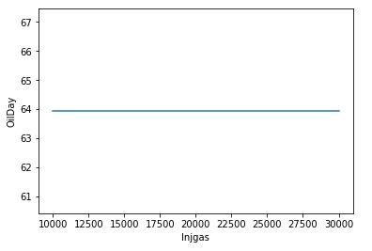
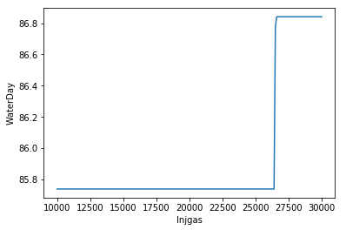
OPTIMUM INJGAS WELL G

Slide 22

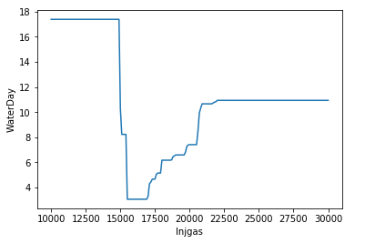
OPTIMUM INJGAS WELL H

